Slide 1
IBM PROJECT
PREDICTIVE MAINTENANCE OF INDUSTRIAL MACHINERY
Presented By: Shubham Arun Sarwar
Student name : Shubham Arun Sarwar
College Name & Department : MIT Academy of Engineering &
Computer Engineering

Slide 2
OUTLINE
Problem Statement
Technology used
Wow factor
End users
Result
Conclusion
Git-hub Link
Future scope
IBM Certifications

Slide 3
PROBLEM STATEMENT
Develop a predictive maintenance model for a fleet of industrial machines to anticipate failures before they occur. This project will involve analyzing sensor data from machinery to identify patterns that precede a failure. The goal is to create a classification model that can predict the type of failure (e.g., tool wear, heat dissipation, power failure) based on real-time operational data. This will enable proactive maintenance, reducing downtime and operational costs

Slide 4
TECHNOLOGY USED
IBM cloud lite services IBM Cloud AutoAI

Slide 5
IBM CLOUD SERVICES USED
IBM Cloud Watsonx AI Studio
IBM Cloud Watsonx AI runtime
IBM Cloud Agent Lab

Slide 6
WOW FACTORS
This model helps industrial stakeholders make faster, more informed maintenance decisions by identifying the type of failure in machinery early. It reduces diagnostic time, enables proactive planning, and increases machine availability.
Unique features:
Failure Type Detection:Classifies issues like tool wear,power failure,etc. Cloud-Based:Scalable deployment on IBM Cloud.
Low-Code Workflow: Built using Watsonx AI Studio’s visual tools.
Real-Time Ready: can be linked to live sensor streams.
Modular Design: Easily extendable to more failure types or tools.

Slide 7
END USERS
Maintenance Teams
Operations Managers
Manufacturing Engineers
OEMs (Original Equipment Manufacturers)

Slide 8
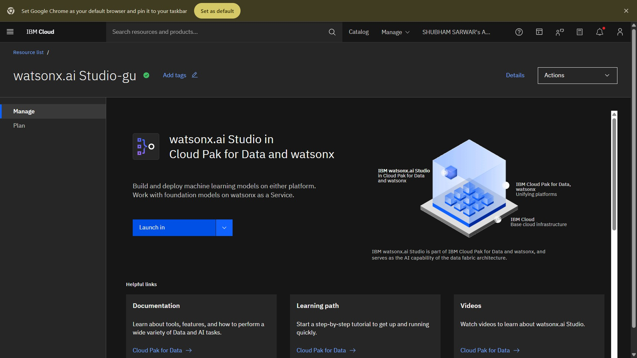
SETTING UP

Slide 9
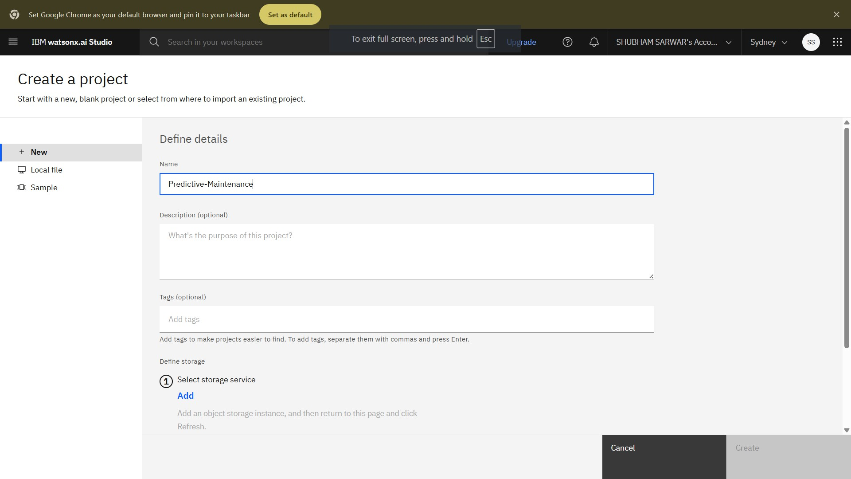
CREATING A PROJECT

Slide 10
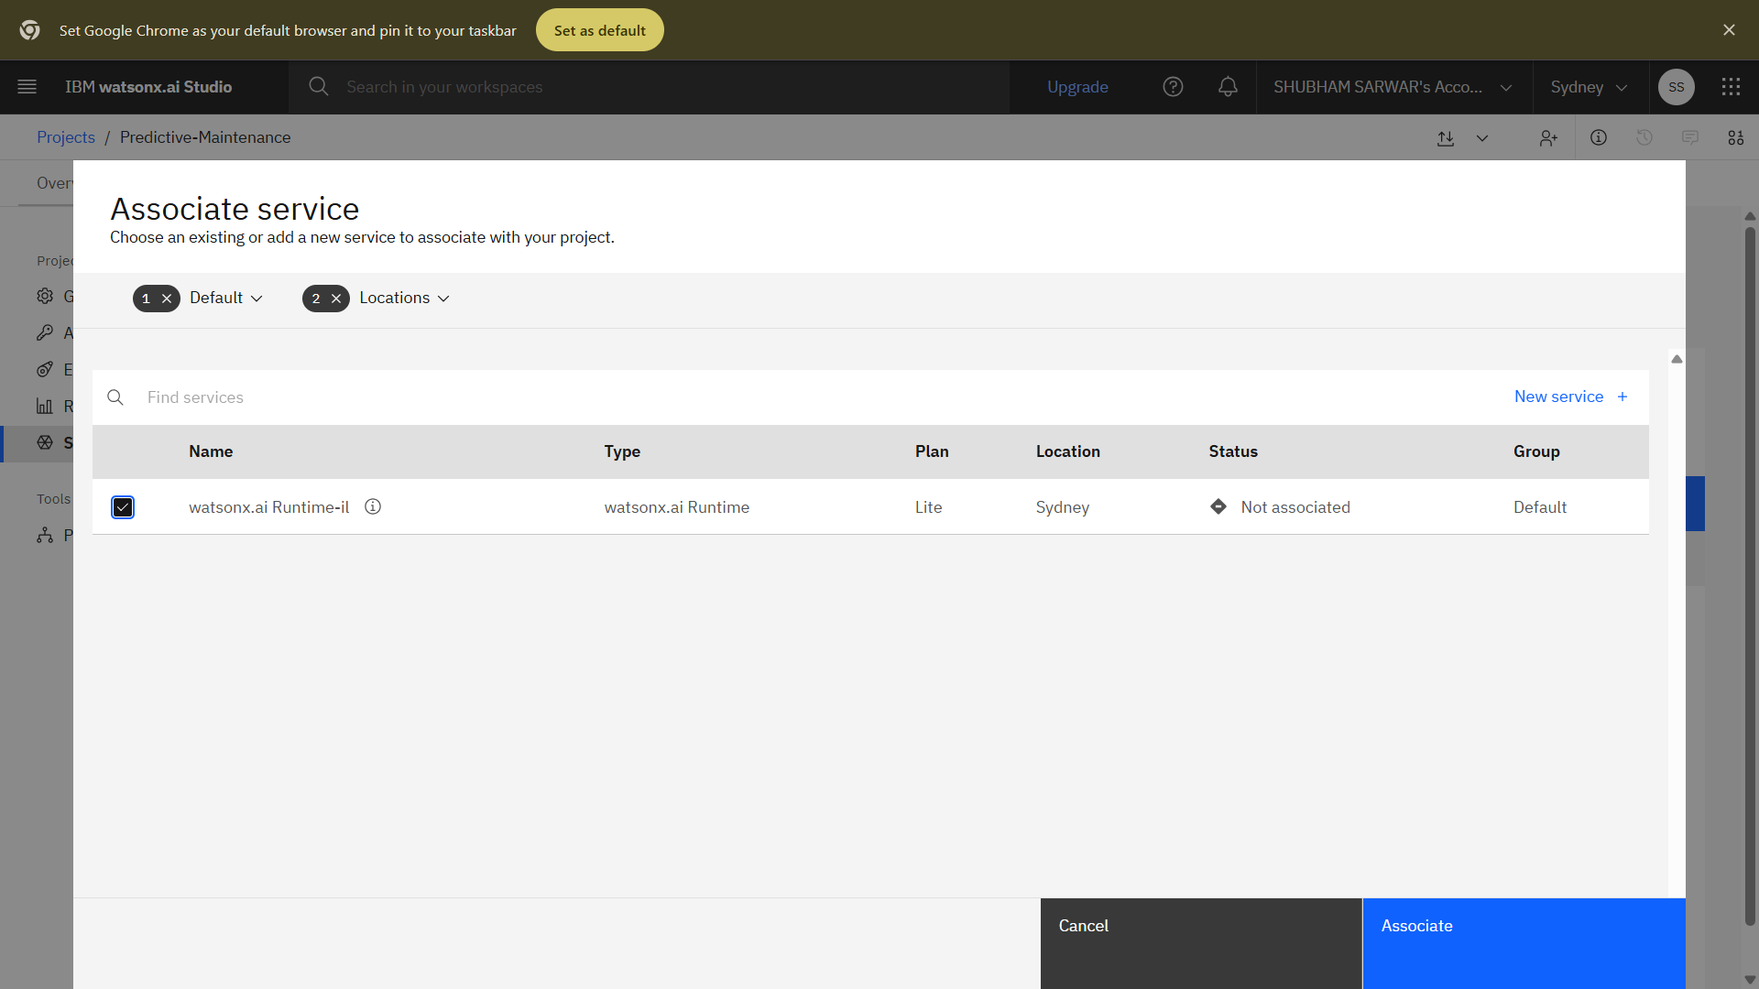
ASSOCIATING SERVICES

Slide 11
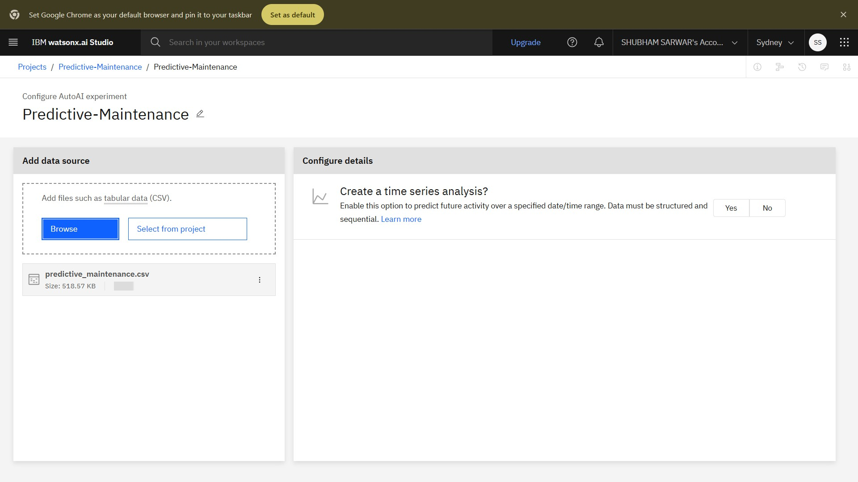
DATA SOURCE

Slide 12
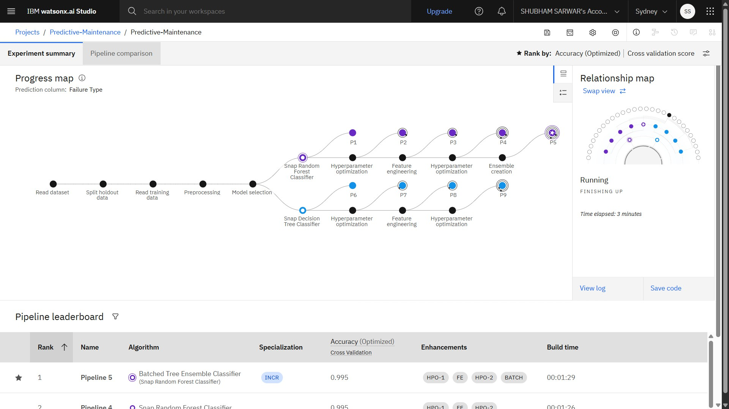
SELECTING MODEL

Slide 13
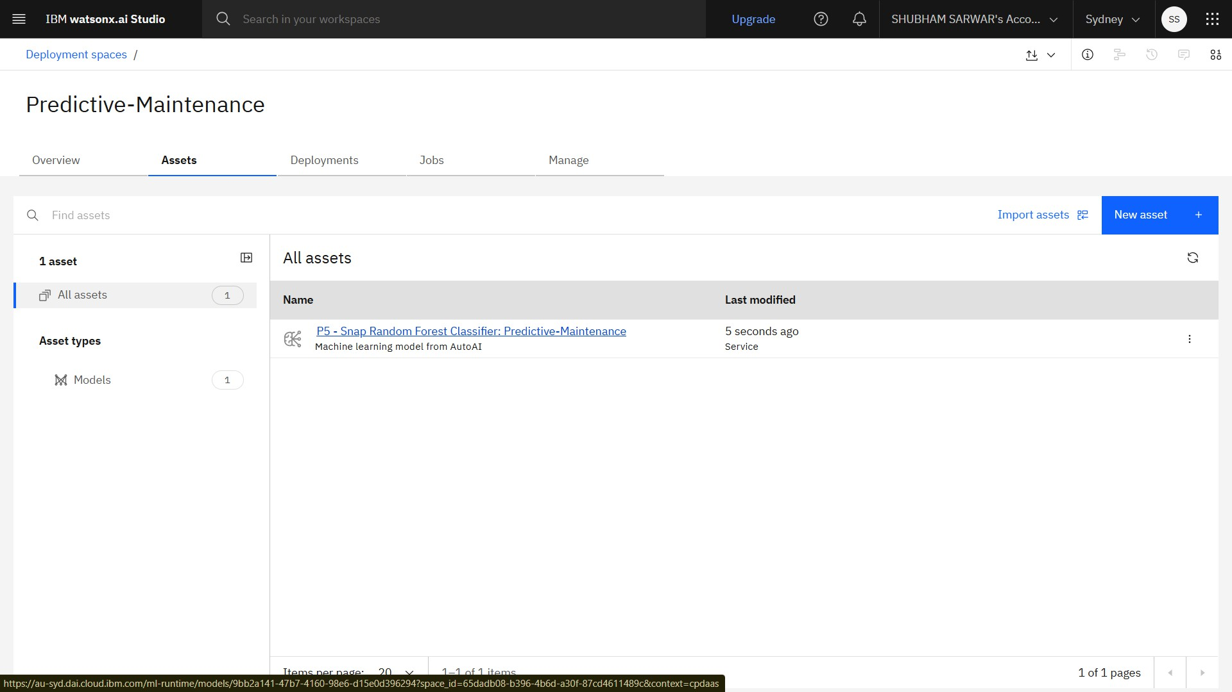
DEPLOYMENT

Slide 14
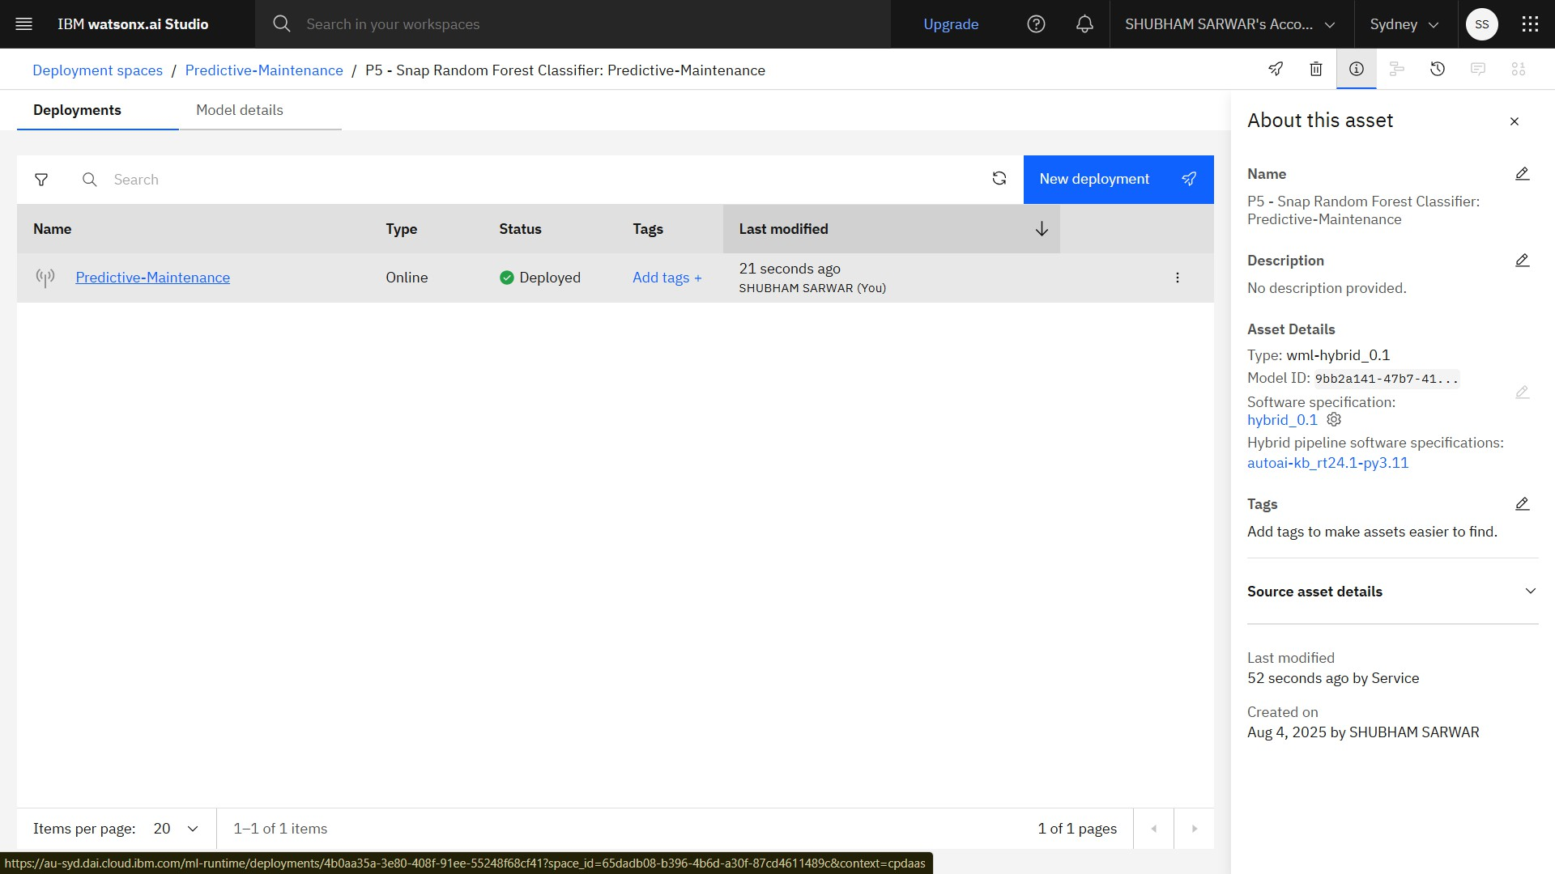
RESULTS

Slide 15
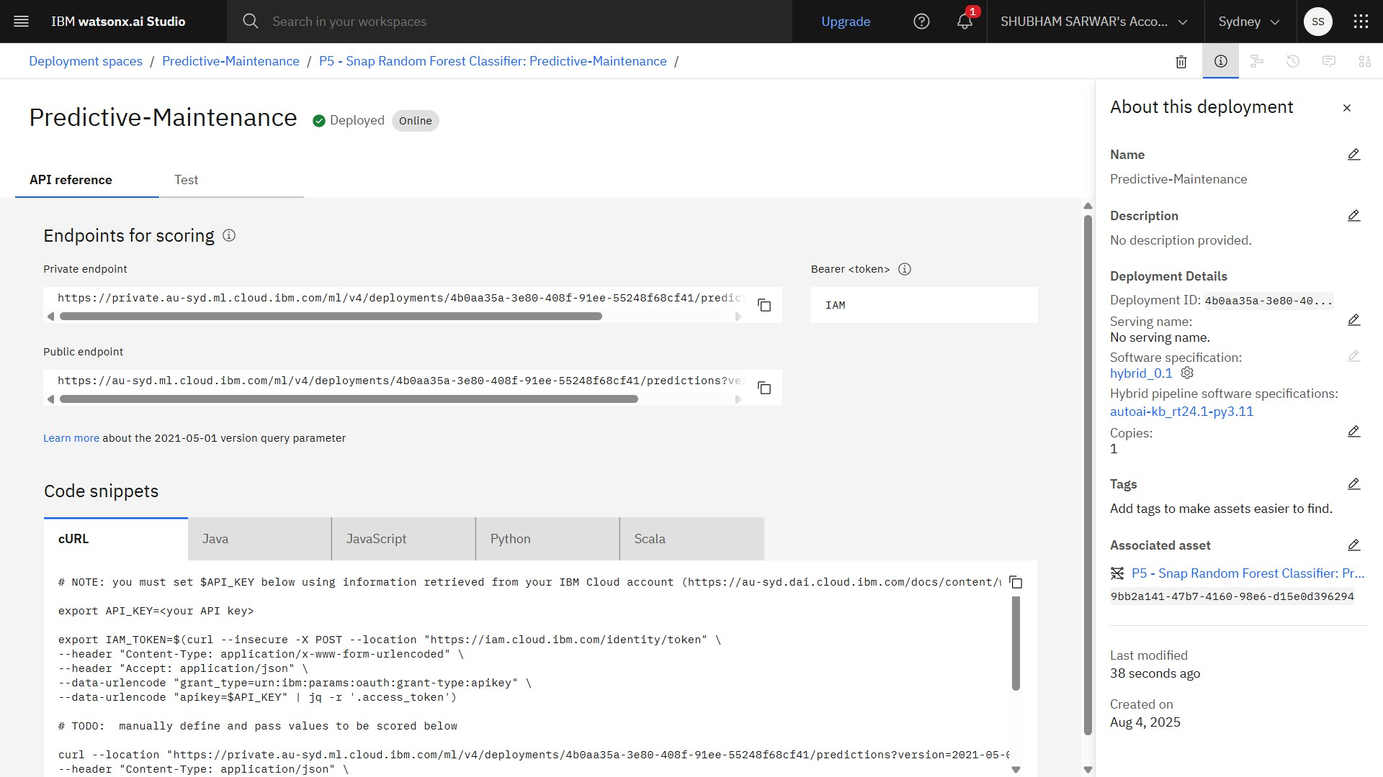
API REFERENCES

Slide 16
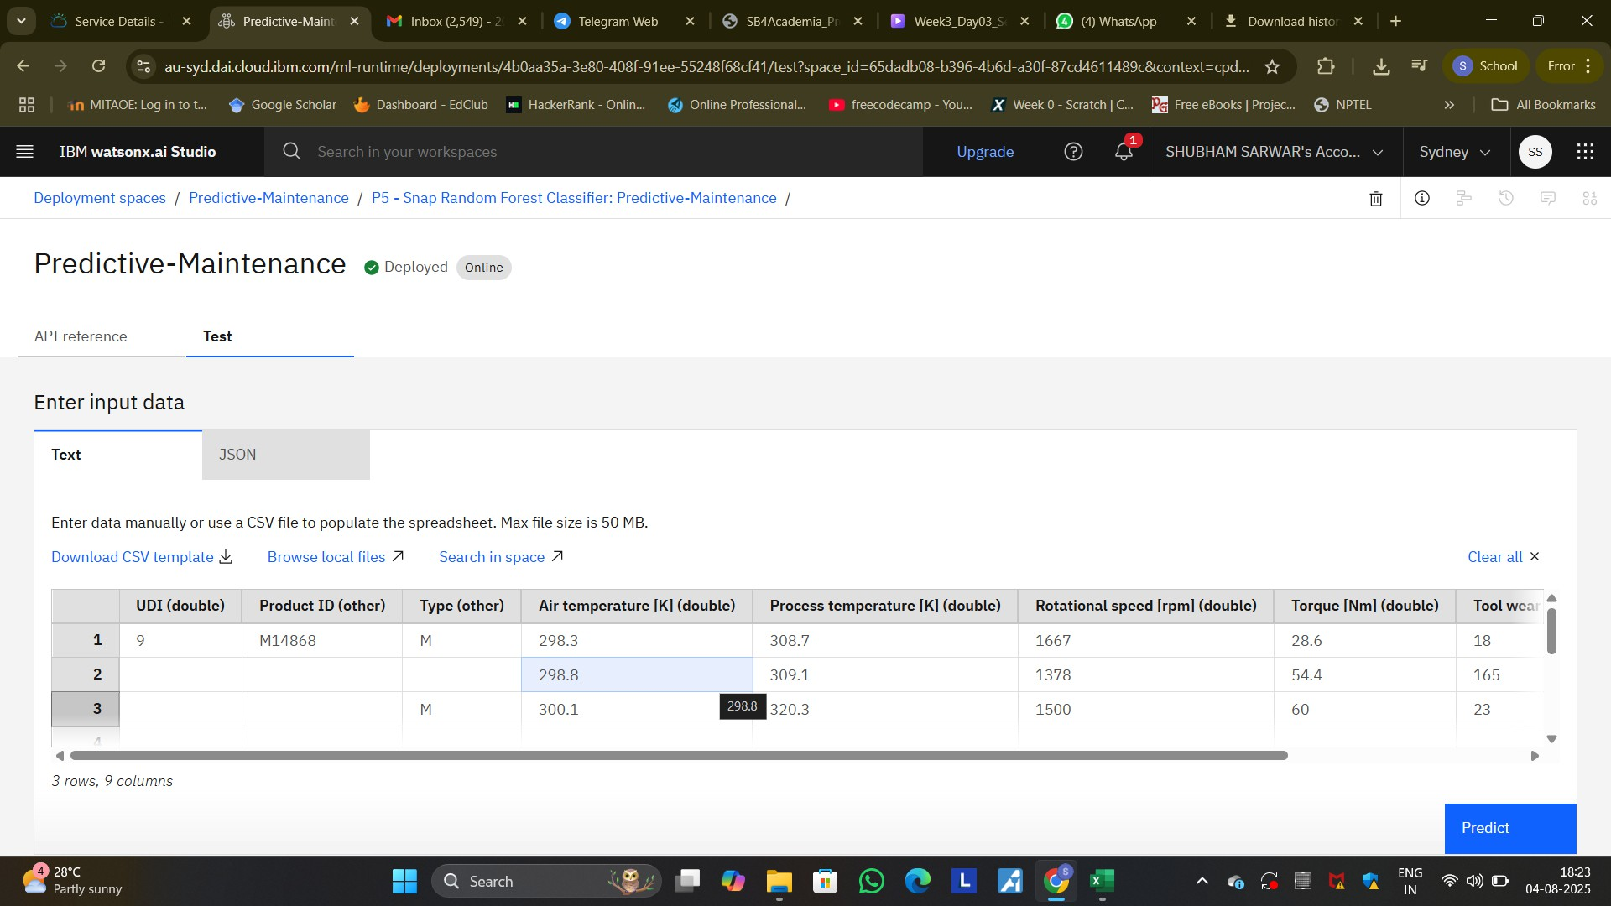
TESTING

Slide 17
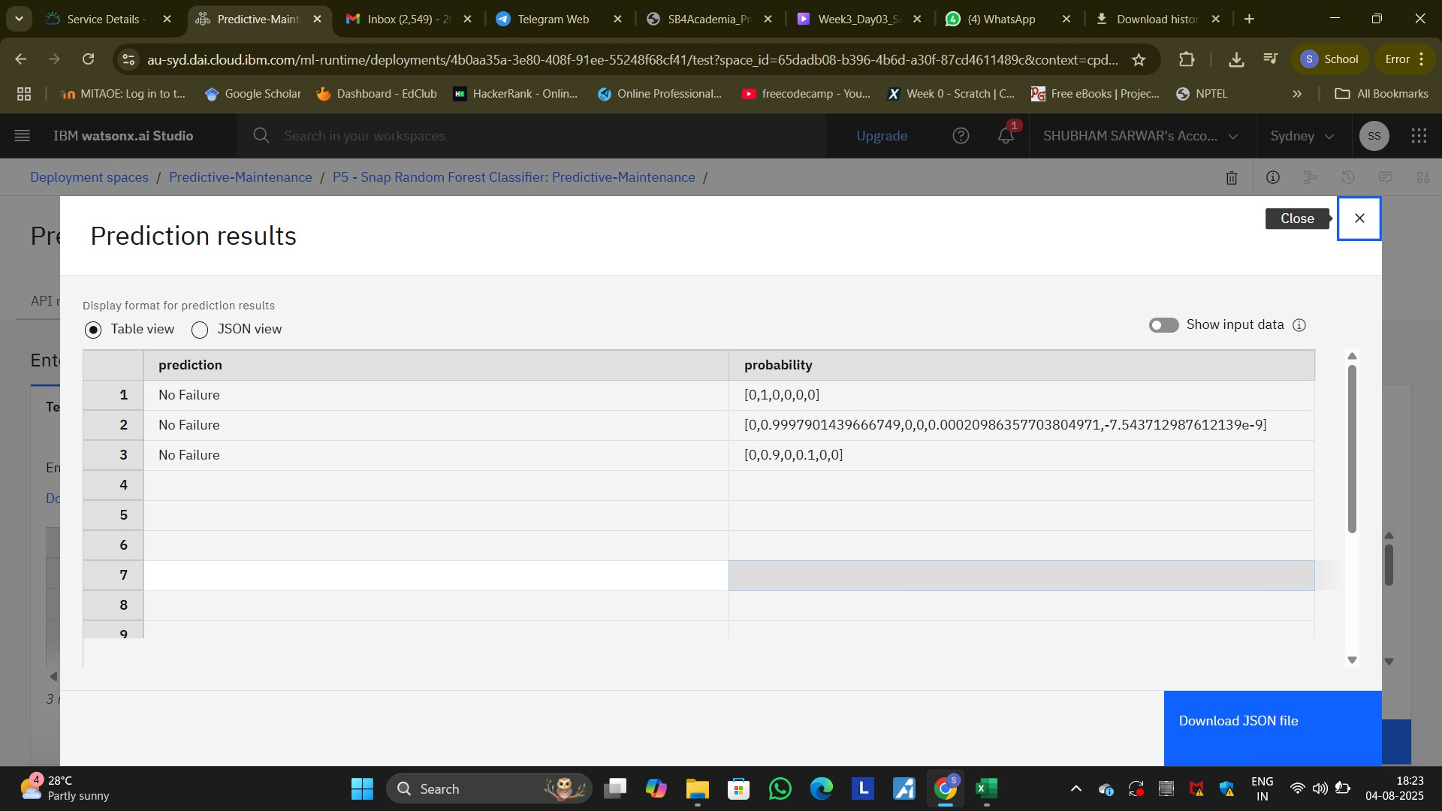
RESULTS

Slide 18
CONCLUSION
Developed a classification model to predict the type of machine failure, using historical sensor data.
Implemented and trained the model with IBM Cloud AutoAI, requiring minimal manual tuning.
Used Watsonx AI Studio, AI Runtime, and Agent Lab to manage, run, and deploy the solution on IBM Cloud Lite.
The model helps identify what kind of maintenance is needed, enabling quicker fault resolution.

Slide 19
FUTURE SCOPE
Multi-Label Classification
Time Series Support
Model Retraining
Integration with IoT
Broader Failure Taxonomy

Slide 20
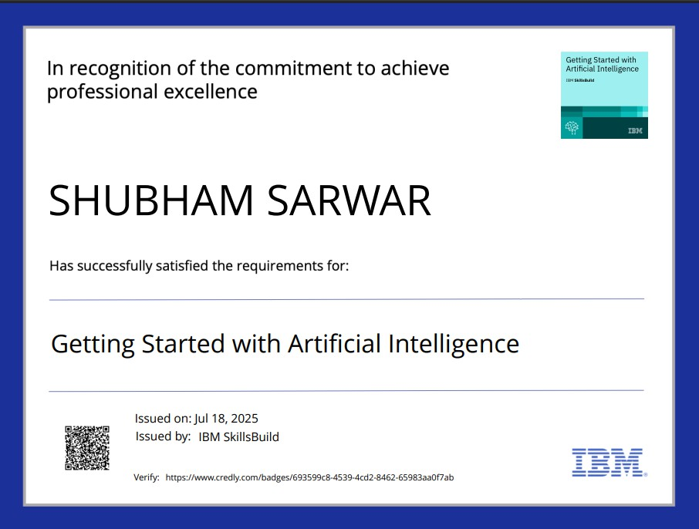
IBM CERTIFICATIONS

Slide 21
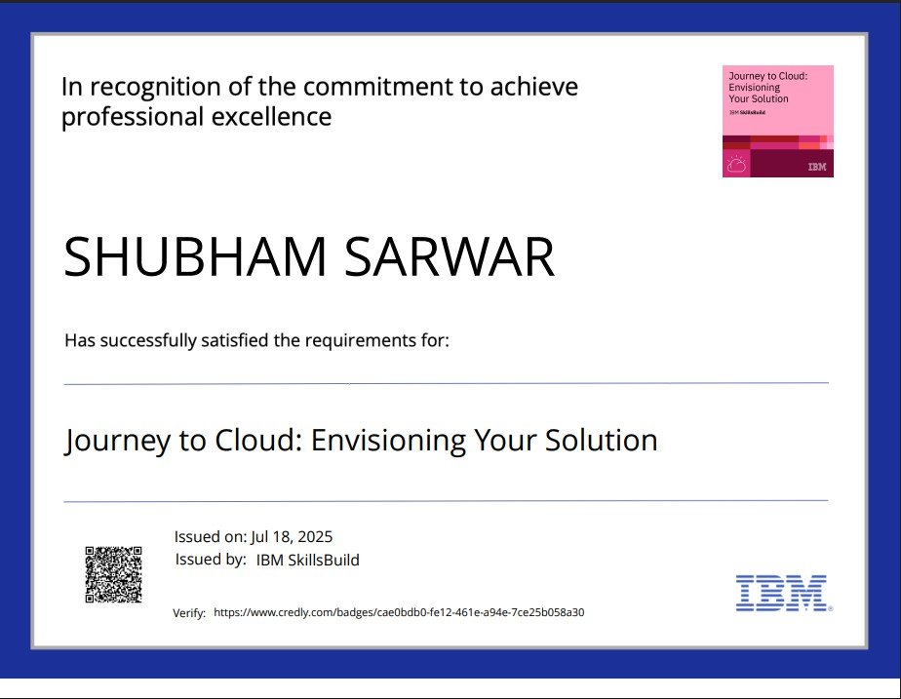
IBM CERTIFICATIONS

Slide 22
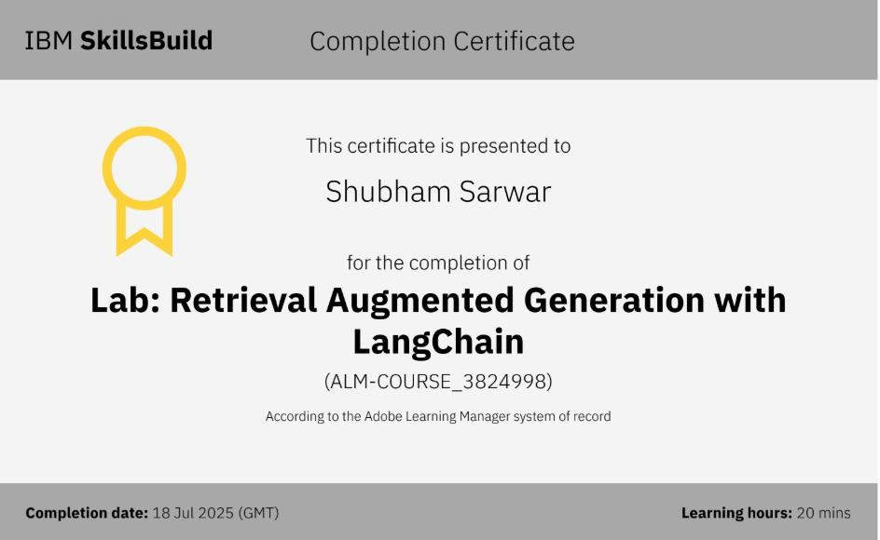

Slide 23
GITHUB LINK
GitHub Link:https://github.com/ShubhamSarwar/Predictive-Maintenance-of-Industrial-Machinery.git

Slide 24
THANK YOU

